Slide 1

Nederland fire protection district public hearing
Petition for Inclusion
Wednesday October 21, 2026
6:00PM

Slide 2
Teams Meeting Basic Features
Change Screen Name
Mute/Unmute
Turn camera on/off
Raise your hand
Signaling us if dialing in
Adding comments to the chat

Slide 3
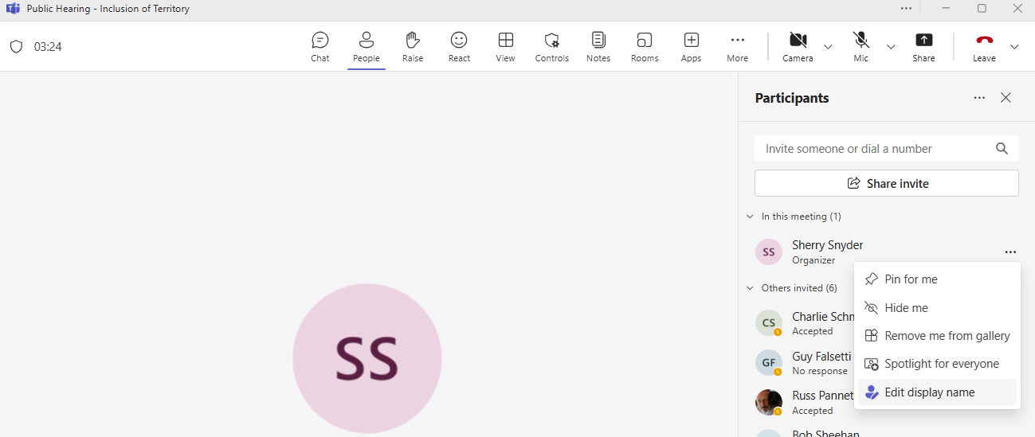
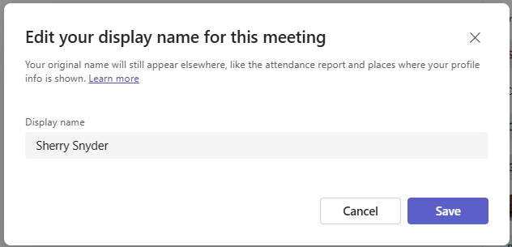
Change screen name
Click on People
In the “Participant” window click on the three dots (more) …
Choose edit display name
Enter your preferred name
Click SAVE

Slide 4

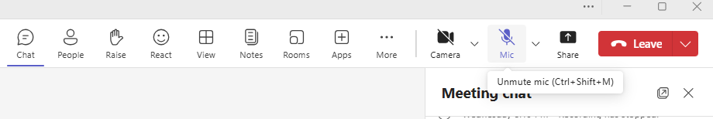
Mute/unmute
Ctrl + Shift + M

Slide 5
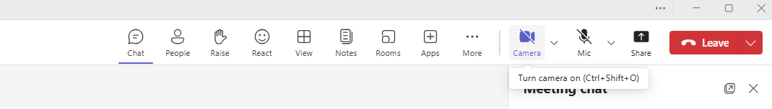

Turn Camera on/off
Ctrl + Shift + O

Slide 6

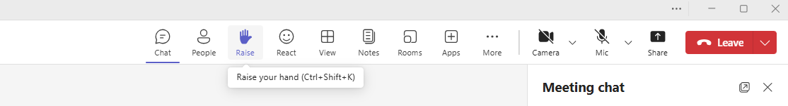
Raise your hand
Ctrl + Shift + K
If dialing in – press *5 on your phone

Slide 7
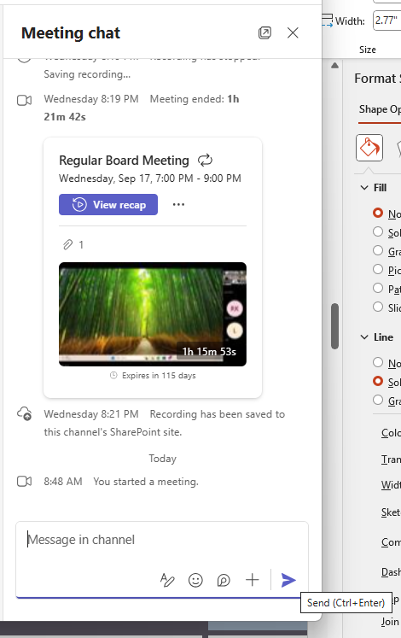
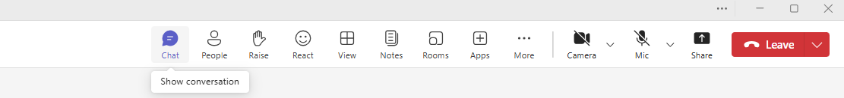
Adding comments to the chat

Slide 8
THANK YOU for your participation
Questions or comments?
Sherry Snyder
admin@nederlandfire.org
(303) 258-9161 ext. 100

