Slide 1
Volunteer Survey
Data Collected December 2023

Slide 2
Grand Fire
We have a variety of things going on, but we don’t really Pay volunteers for volunteering. We do some pay for some things:
We have a resident program that they get free housing and training in exchange for shifting
We have traditional volunteers that generally don’t get paid, but some (depending on qualifications) do get paid a stipend ($150/day) for being duty officer over the weekend.
We have a wildland program that we hire seasonals
Sometimes we have Residents or Volunteers that apply and will hire them for the summer
Sometimes we have a residents or volunteers go on national assignment, and we do pay them for that.
Working with our attorney, we are careful not to make wildland program or national assignments part of their job description, so we can pay, as long as we don’t pay more than 20% of what a career firefighter makes over the course of a year.
We do a holiday bonus, mostly as a thank you to our volunteers, residents and staff. It’s a blend of a base amount, and additional for those that go above and beyond “good standing” for training, community events, and calls.
We use our pension board good standing for volunteers, we add to that to create a good standing marker for the residents that are on duty two days a week and required to be at all department trainings. We pretty much do a flat rate for staff as we have relatively few, and their job descriptions are so varied.

Slide 3
Golden
Requirements
3 12-hour shifts per month or 9 over the quarter.
60 hours of training/year
1 community event
Attendance at 6 monthly business meetings
Stipend
Currently $45 per 12-hour shift. Looking to increase it to $100 in 2024.
LOSAP
If volunteers meet their requirements, they have between $600 and $3000 put into an account they draw when they leave.
The amount is dependent on rank, member of special teams, driver, etc.
Pension
We have a few volunteers still in our pension which pays at age 50. I think the current amount is $750/month at 10 years and goes up with each additional year.
We stopped the pension for new members years ago and now have a “Other than pension” lump sum payout. I’m unsure on how much but they had talked around $40,000 I believe.

Slide 4
Central City
The department has a Length of Service Plan which is essentially a 457(e) and money is allocated to that account accordingly:
Years of service Award amount
1 $600
2-5 $700
6-10 $1000
11-15 $1500
16-20 $2000
21+ $3000
A member has to meet minimum requirements (which is the same throughout the State) which is 36 hours of training. The department also requires a 15% response to the calls for the year, we generally run around 400/calls a year.

Slide 5
Timberline Fire
We currently do not pay our volunteers. Our FPPA volunteer pension was closed in 2012, and we offer no response stipend to anyone other than a few volunteers who take a Duty Officer position on the weekends (daily meal stipend only).

Slide 6
Laramie County Fire Authority
We have approx 100 volunteers here. We do offer a pay per point program as well. We budget $80,000 per year and divide that up per quarter and assign a dollar value to each point. We use the limits that FSLA requires for each position to set a capped amount. I will attach our pay per point policy. We do have a 24 hour per month minimum shift policy as well for our volunteers to maintain a good standing with the organization as well as fulfill state volunteer firefighter pension requirements. The majority of our training is completed on shift. Please let me know if you have any other questions.

Slide 7
Laramie County Fire Authority

Slide 8
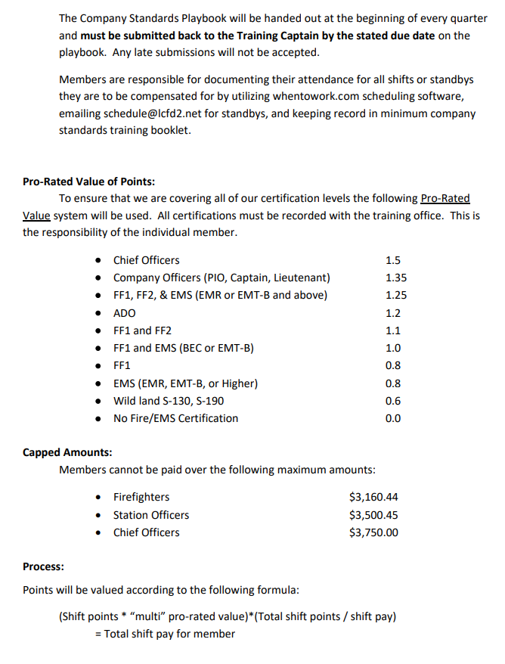
Laramie County Fire Authority

Slide 9
Four Mile Fire Protection District
Right now, Four Mile is not doing any sort of stipend program for call response. For volunteers, we pay for trainings, provide in-house trainings (and try to provide dinner or some snacks), have pro-deals from outdoor retailers, and provide volunteers with any additional needs they may have as a volunteer (PPE, Four Mile shirts, etc).
However, as I mentioned, we are low on volunteers and a majority of our calls have members of our paid mitigation/wildland crew attending. We do have a core group of volunteers/volunteer Officers who show up to calls, but we are doing a large recruitment push this spring to try and build our volunteer base. If we come up with any of our own ideas for recruitment/retention, or start to implement a stipend program, I'll keep you in the loop!

Slide 10
Coal Creek Canyon Fire Department
We budget a total amount for stipends each year, that total is then allocated out based on formula that looks at how many calls, trainings and events each FF attended with incidents and trainings having a heavier allocation weight.
We pay an annual stipend based on call, training and event attendance. We also have an appreciation/end of summer BBQ annually and give out SWAG annually (appreciation/retainment).

Slide 11
Nederland Fire
Host and provide training opportunities for volunteers
Pay for certification so volunteer are eligible for fire jobs outside Ned
Allow volunteers to go out as single resources on paid wildland deployments
Provide SWAG for volunteers
$5 per response call paid at the end of year
Holiday party where we recognize outstanding contributions by volunteers

